Slide 1
Introduction to xml
Session 01

Slide 2
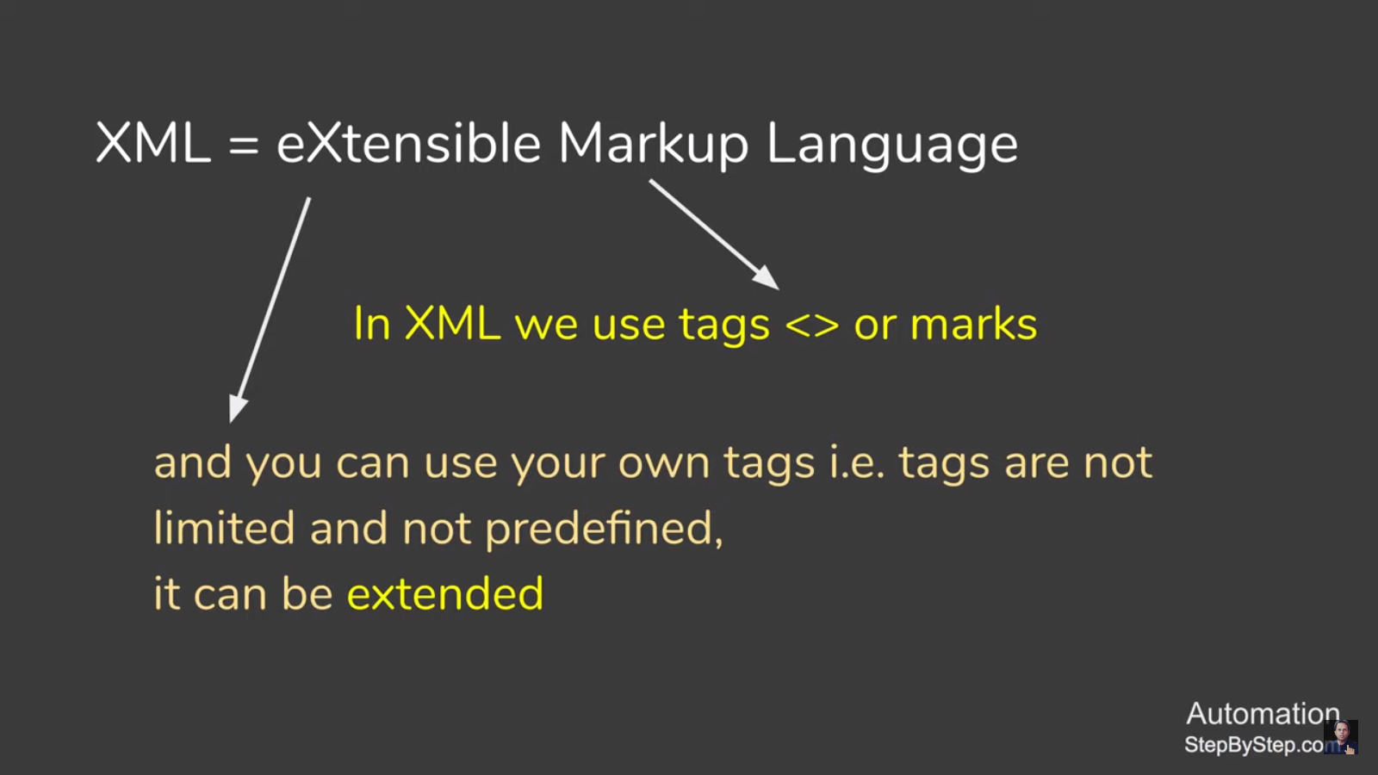
What is an XML?
XML stands for eXtensible Markup Language
XML is a markup language much like HTML
XML was designed to store and transport data
XML was designed to be self-descriptive
XML is a W3C Recommendation
XML uses a Document Type Definition (DTD) or an XML Schema to describe data

Slide 3
XML Markup
XML markup defines the physical and logical layout of the document.
XML markup divides a document into separate information containers called elements.
A document consists of one outermost element, called root element that contains all the other elements, plus some optional administrative information at the top, known as XML declaration

Slide 4
Difference btw html and xml
HTML | XML
HTML was designed to display data. | XML was designed to carry data.
HTML displays data and focuses on how data looks. | XML describes data and focuses on what data is.
HTML displays information. | XML describes information.

Slide 5
Parsers
An XML parser:
  Reads the document
  Verifies it for its well-formedness
  After verification, converts it into a tree of elements
Commonly used parsers:
  Crimson, Xerces, Oracle XML Parser, JAXP, MSXML
Type of parsers:
  Non Validating parser
  Validating parser

Slide 6
Parsers
Non Validating parser
It checks the well-formedness of the document.
Reads the document and checks for its conformity with XML standards.
Validating parser
It checks the validity of the document using DTD.

Slide 7
browsers
Web browsers can format XML data and display it to
the user.
Other programs like database, Musical Instrument Digital Interface (MIDI) program or a spreadsheet program may present XML data accordingly.
Commonly used web browsers:
  Netscape, Mozilla, Internet Explorer, Firefox, Opera

Slide 8
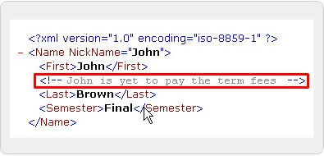
Comments
Used for the people to give information about the code
Usually made for the content

Slide 9

Example syntax

Slide 10
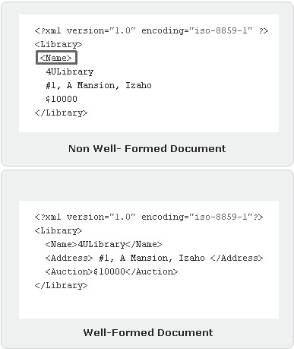
Structure of well and non well formed document

Slide 11
Tags, prolog and root elements
Code Snippet
<?xml version=”1.0” encoding=”iso-8859-1” ?>
- <FlowerPlanet>
<Name>Rose</Name>
<Price>$1</Price>
<Description>Red in color</Description>
<Number>700</Number>
</FlowerPlanet>
where,
<Name>, <Price>,<Description> and <Number> tags are
elements
<FlowerPlanet> and </FlowerPlanet> are the root elements

Slide 12
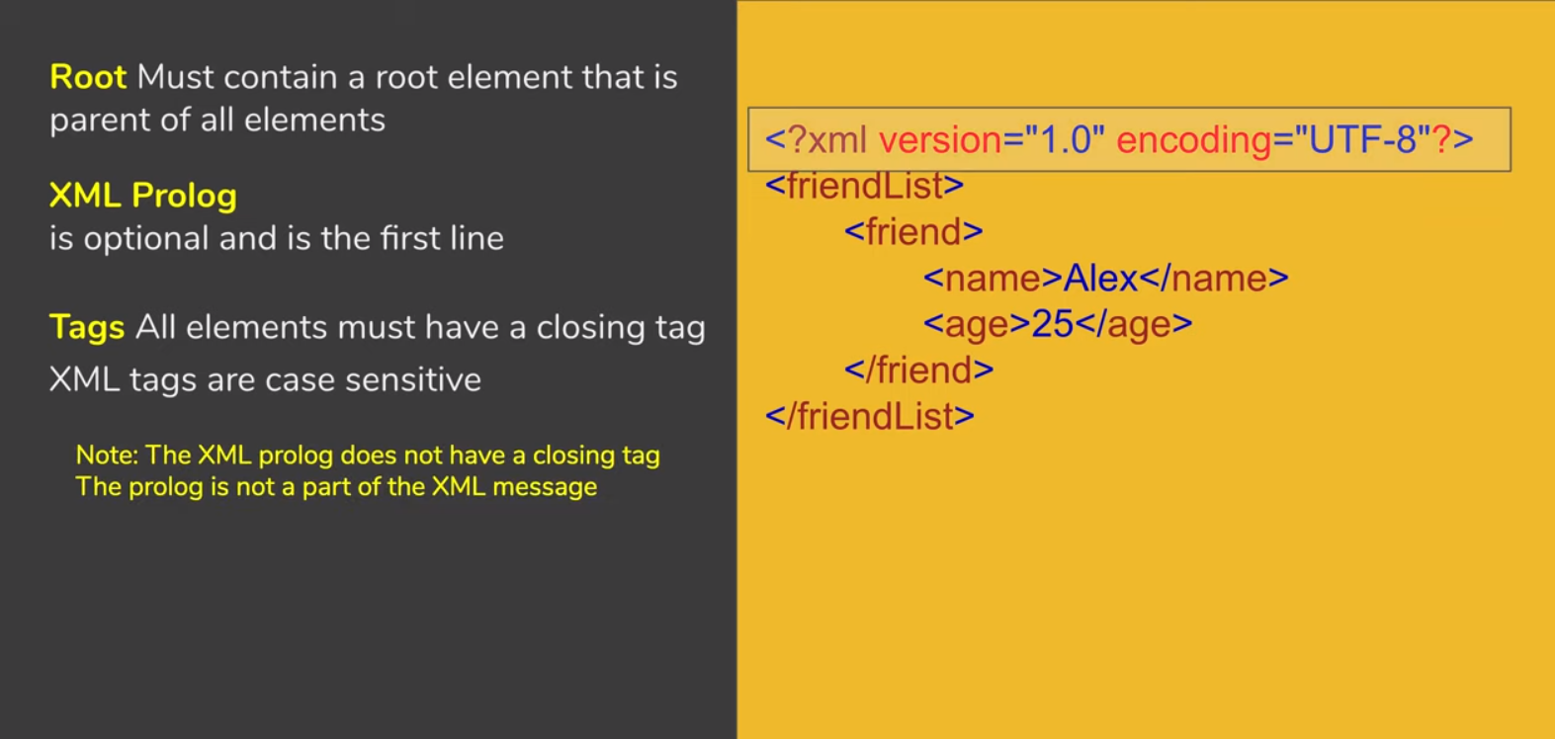
Tags, prolog and root elements
This is the XML optional preamble. version="1.0" means that this is the XML standard this file conforms to. encoding="utf-8" means that the file is encoded using the UTF-8 Unicode encoding

Slide 13
Xml Editors
The popularly used editors are:
  XMLwriter
  XML Spy
  XML Pro
  XMLmind
  XMetal

Slide 14
Creating an XML document
The steps to build an XML document are as follows:
Create an XML document in an editor
Save the XML document
Load the XML document in a browser

Slide 15
Task
Create an Employee File to store the following fields in XML.
  EMPNO,ENAME,DESIGNATION,SALARY AND DEPTNAME
Create Department file that contains the information of all the departments present in an organization.
  DeptNo, DeptName, Location

Slide 16
Print this student data in xml format
sid | fname | lname | Y_of_B
50 | David | Dave | 1984
23 | John | Jones | 1983
53 | John | Smith | 1983
55 | Mike | Green | 1985
54 | Ann | Webb | 1980
57 | Cathy | Brown | 1981
60 | Nick | Smith | 1979
62 | Sue | Moor | 1976
64 | George | Wolf | 1978
58 | Harry | Potter | 1983

Slide 17
Online xml code checker for movies
To check a xml code for movie visit :https://www.omdbapi.com/

